Slide 1

Welcome to Science
We will identify the expectations of this classroom

Slide 2
Do not delete this slide.
This slide is designed so that you can copy the prompt box you need and insert it into your slides.
This slide is hidden and will not be included when presenting your lesson.
TRACK WITH ME
VOCABULARY
1 -
HINT
Students, remember….
CHECK FOR UNDERSTANDING
READ WITH ME
TEACHER CUE
MAKE THE CONNECTION
Students, you already know….
EXTENSION

Slide 3

Line up in alphabetical order using your first name without talking

Slide 4

Acknowledgement of Country
Notes:
I would like to begin by acknowledging the Whadjuk Noongar people, Traditional Custodians of the land on which we meet today, and pay my respects to their Elders past and present. I extend that respect to First Nation peoples here today.'

Slide 5

We will identify₁ the expectations of this classroom
TRACK WITH ME
READ WITH ME
VOCABULARY
1 – to recognise something or someone
DECLARE THE OBJECTIVE
Read the learning objective to your partner.
Notes:
Learning Objectives contain concepts (nouns, big ideas), skills (verbs, measurable behaviours) and sometimes context (restricting or targeting conditions).
●Example: Students will be able to describe the concept of density and apply it to floating and sinking.
●
Success criteria are specific measurable outcomes that if met mean that the student has met the learning objective.
Examples:
•Students will be able to compare densities of substances using mass and volume.
•Students will be able to identify whether a solid or liquid will float or sink in a liquid based on their densities.

Slide 6

We will identify₁ the expectations of this classroom
About Me

Slide 7
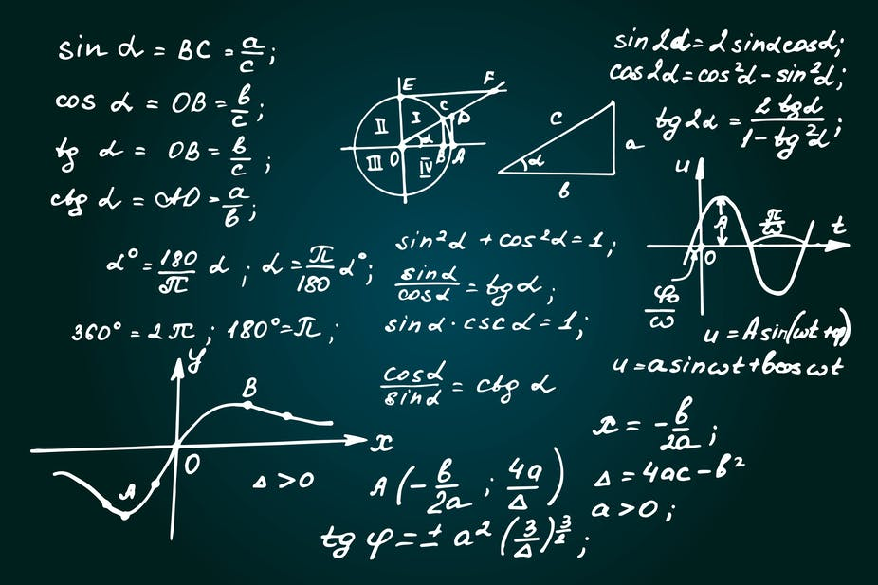
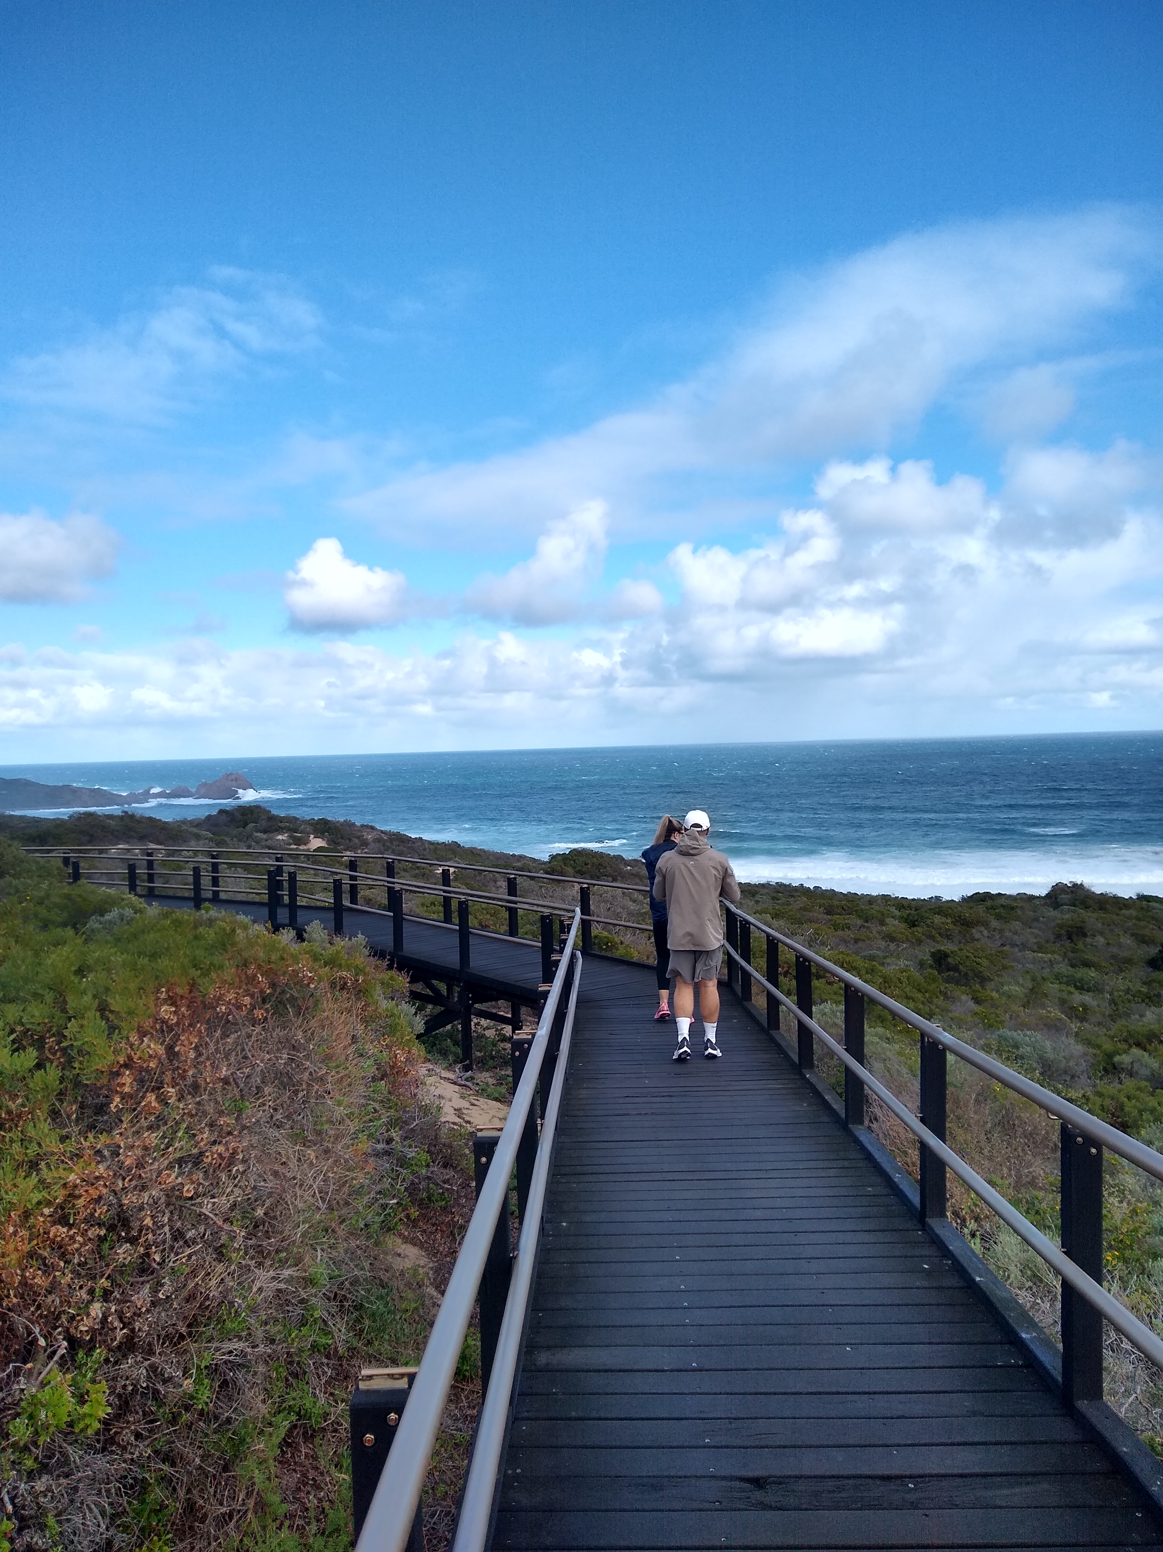
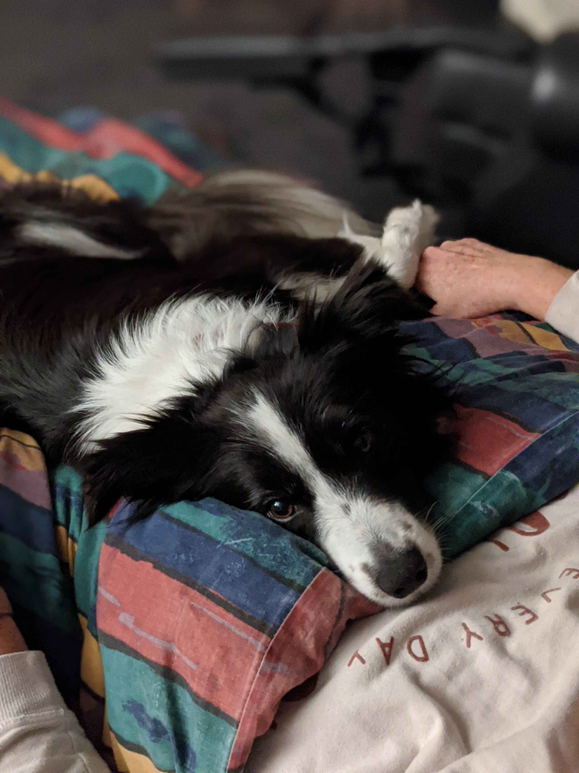


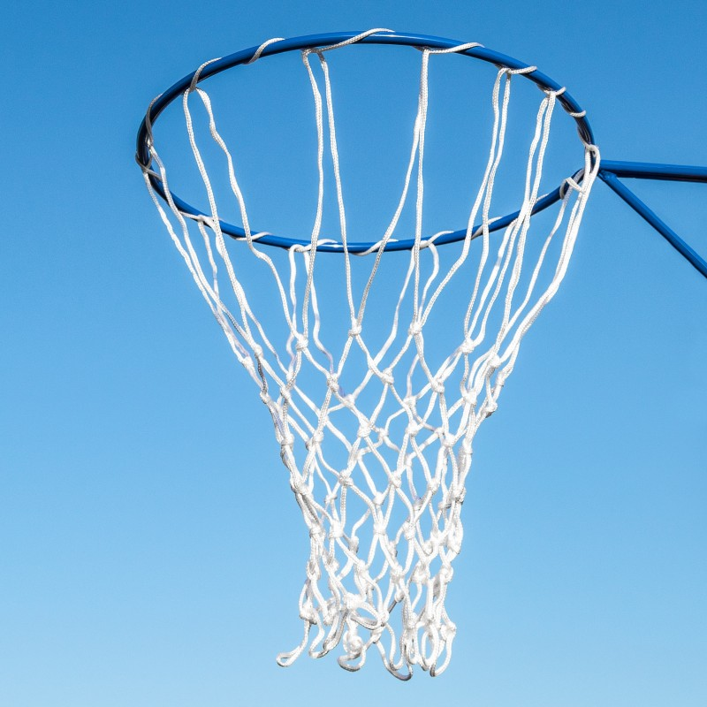

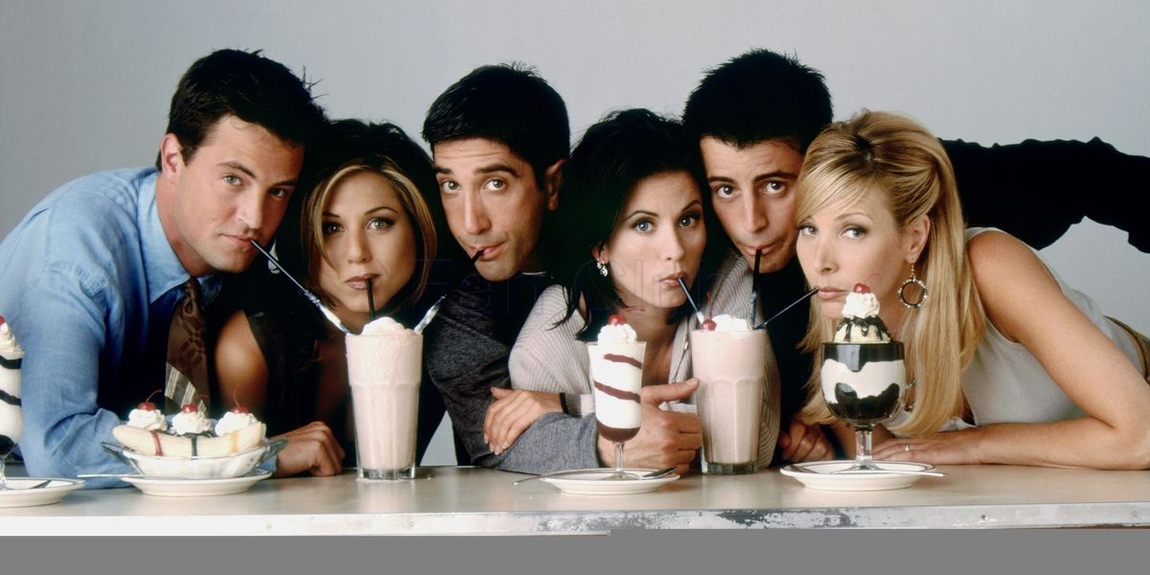

Slide 8

We will identify₁ the expectations of this classroom
What does a successful classroom look like?
STUDENTS
CLASSMATES
TEACHER

Slide 9

We will identify₁ the expectations of this classroom
MAKE THE CONNECTION
Why are rules important? What are some rules you follow at home? Why are rules important at the airport? Movie theatre?
Class Expectations
Phones off and away
No food or gum
Follow instructions
No hats and correct uniform
No earphones
Appropriate language
Be on time

Slide 10
We will identify₁ the expectations of this classroom
Behaviour
Responsibility
Everyone participates in the class, there is no opting out.
Respect each other
Hands up for questions
Always be prepared
What you need to take notes
Homework that is due
Complete assigned work and submit on time
If you missed a class, it is your responsibility to catch up on what you missed
If you need help, you only have to ask either in class, after class or email your teacher

Slide 11
We will identify₁ the expectations of this classroom
Start of the lesson
Line up at the door before class
Collect what you need from your bag
Put your bag in a bag cubby
Sit in your assigned seat
Start your DO NOW

Slide 12

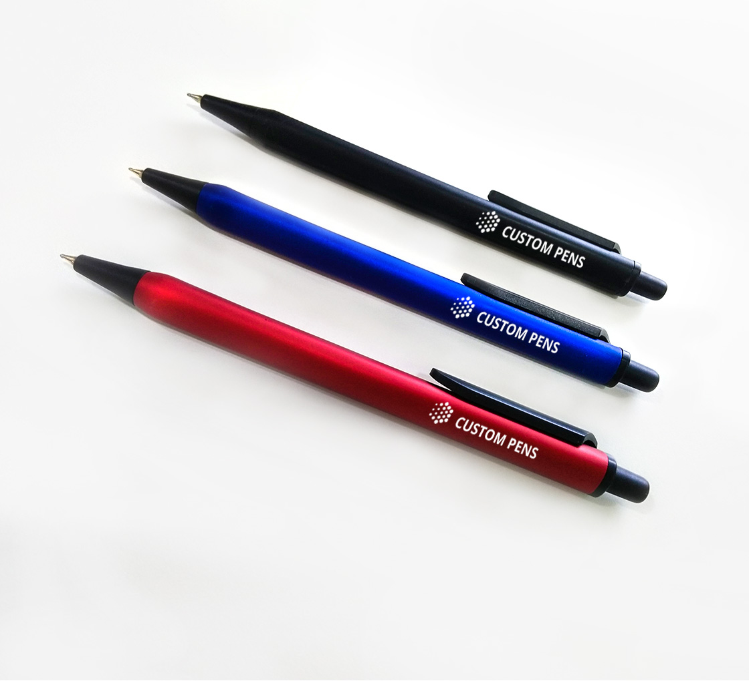
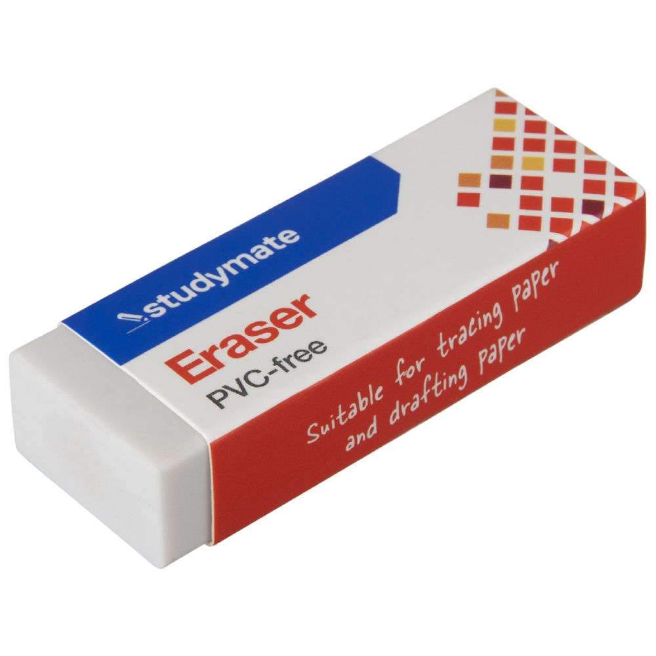


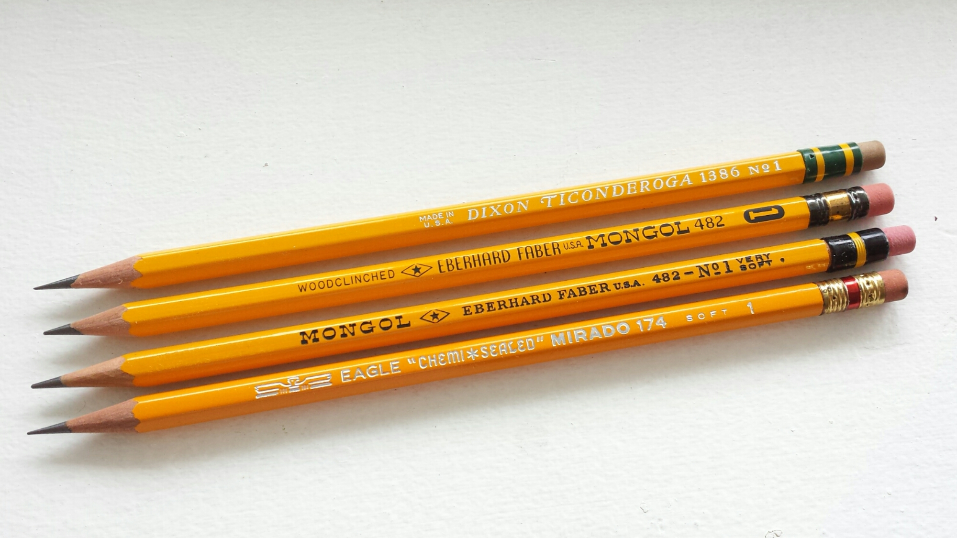
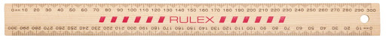
We will identify₁ the expectations of this classroom
▼ Kept in Classroom ▼
What will you need for Science?

Slide 13

We will identify₁ the expectations of this classroom
Ms Alex’s Motto: GROWTH MINDSET

Slide 14

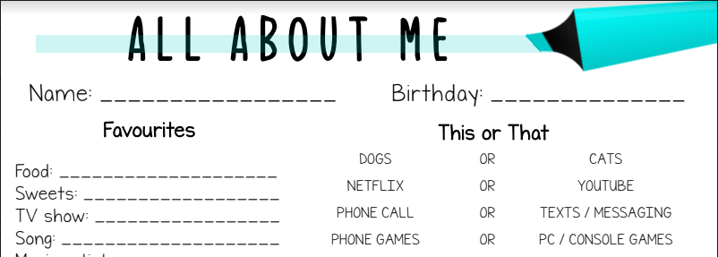
5 minutes
We will identify₁ the expectations of this classroom
Getting to know you survey

Slide 15

We will identify₁ the expectations of this classroom
What am I?

Slide 16
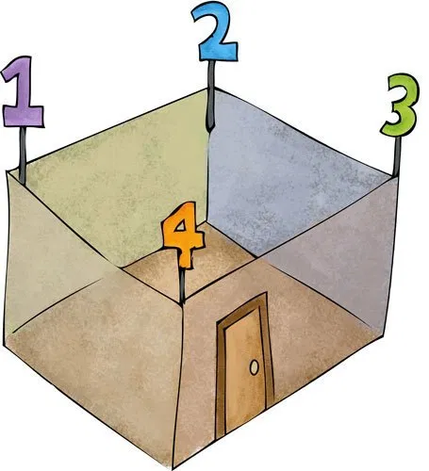
Four Corners Game
Expectations:
Use the allocated think time to make your own decision
Move to your chosen corner on my instruction
Always walk quietly
You must pick from one of the answers given

Slide 17

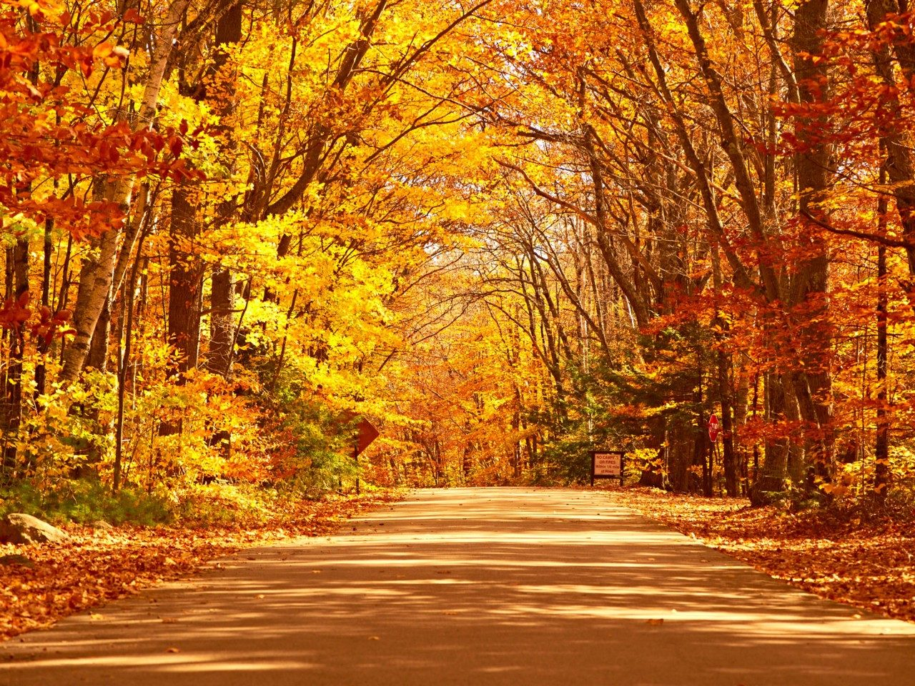
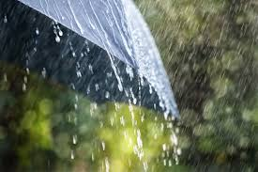
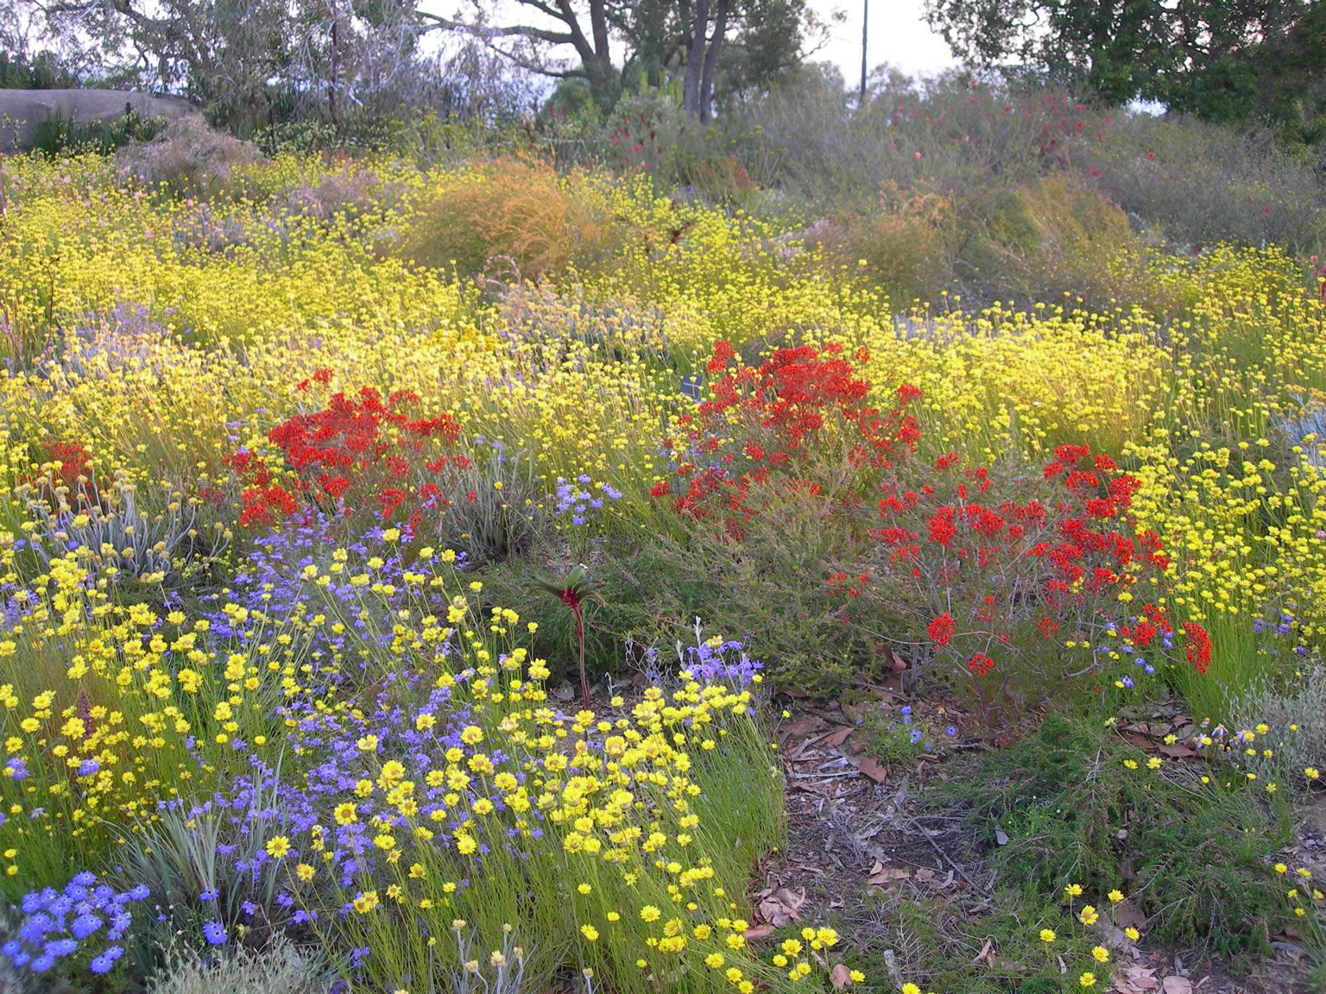
What is your favourite season?
1
2
3
4

Slide 18
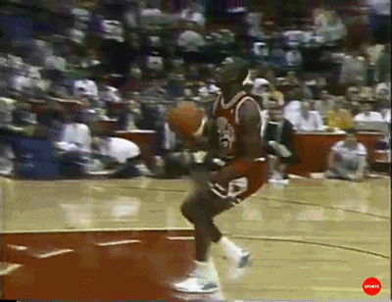
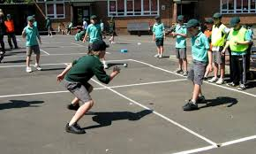

What do you like to do at lunch time?
1
2
3
4
Other

Slide 19

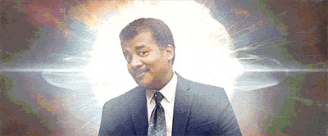
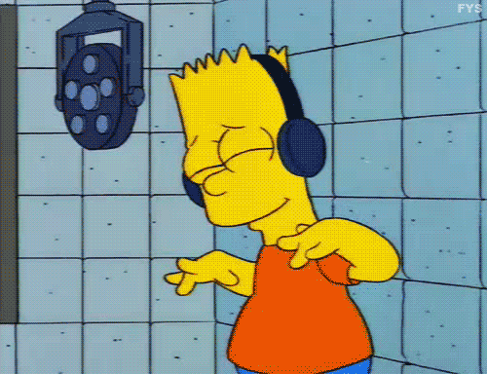
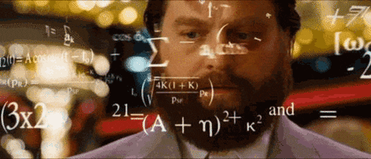
What is your favourite subject?
1
2
3
4

Slide 20

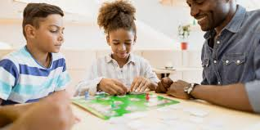
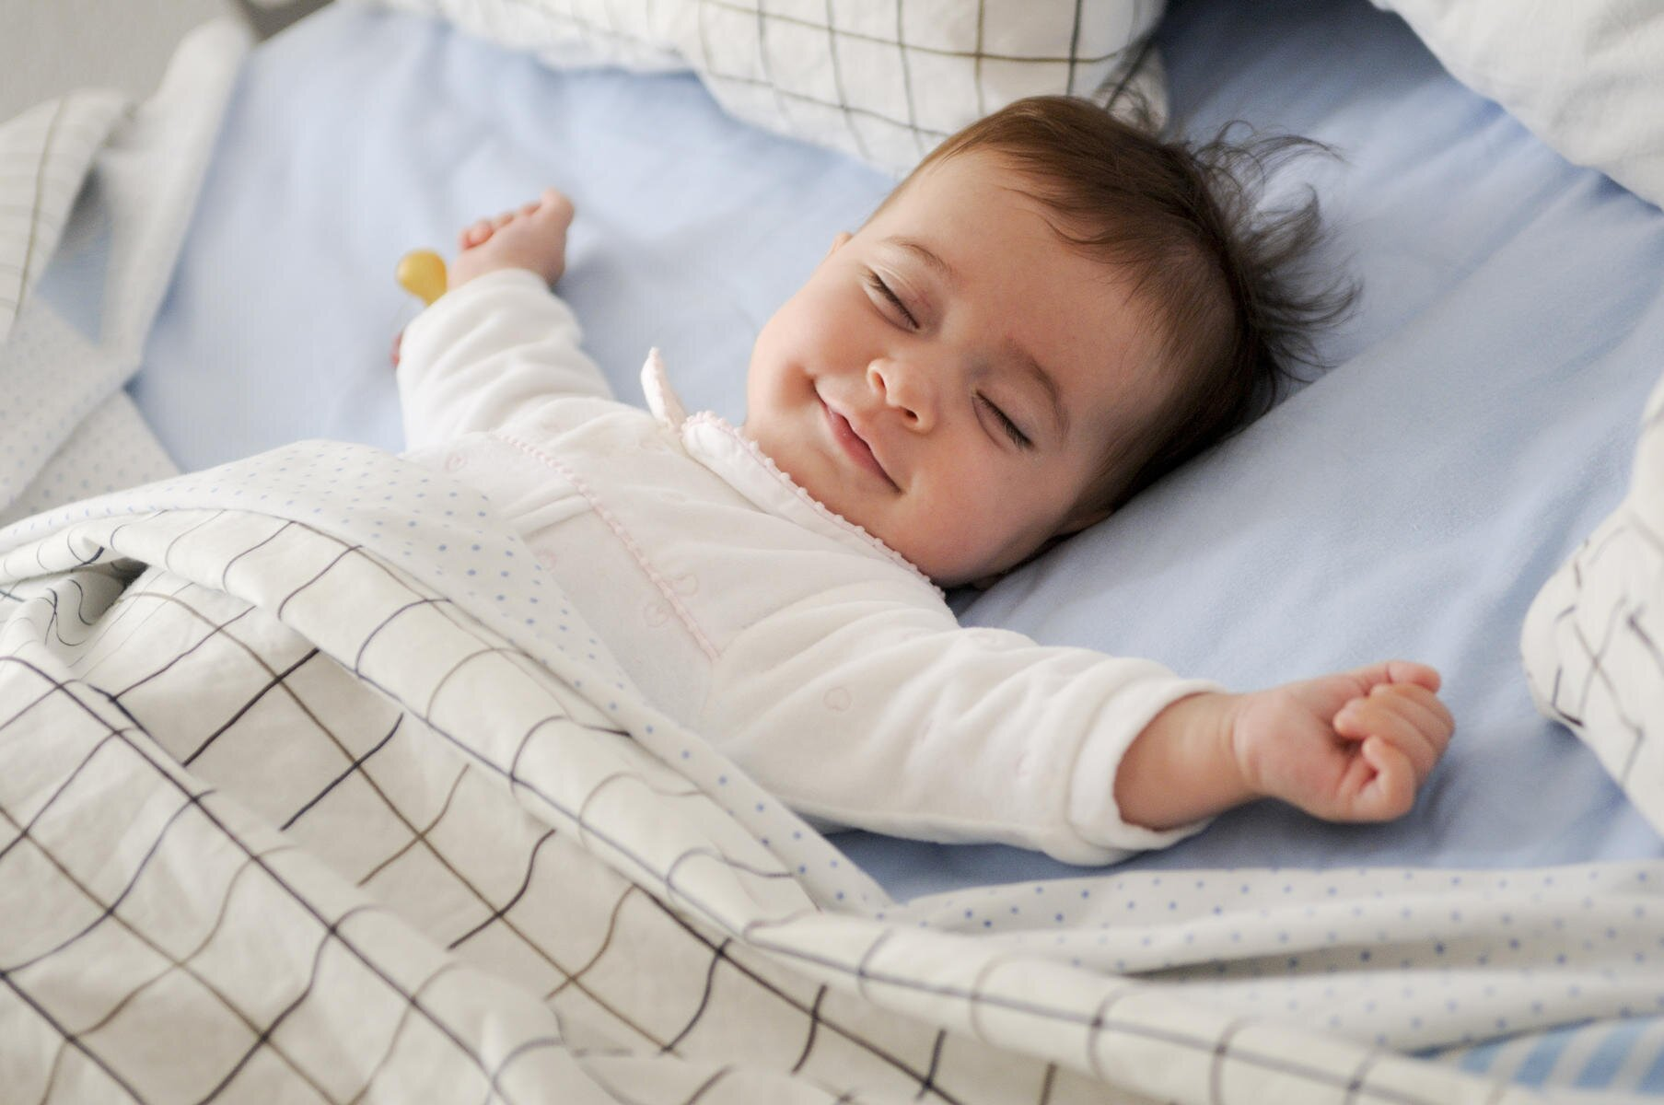
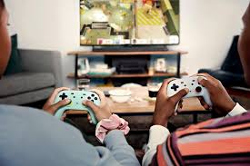
What do you like to do at home?
1
2
3
4

